Slide 1

ICE 3161
COMMUNICATION ENGINEERING
Dr. Asif Zaman
Professor, CSE, RU

Slide 2
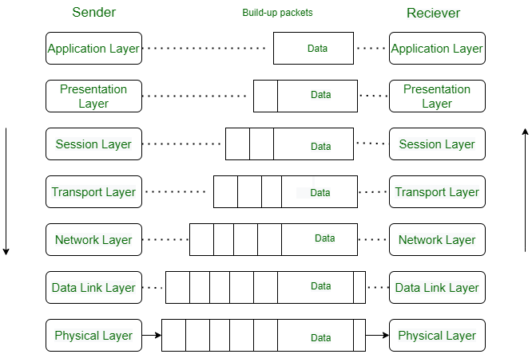
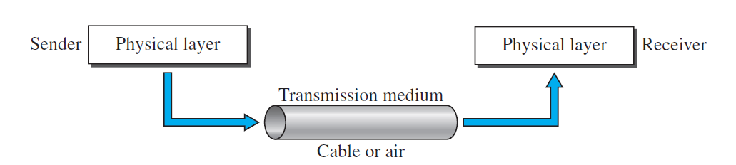
Transmission media
Transmission media are actually located below the physical layer and are directly controlled by the physical layer.

Slide 3
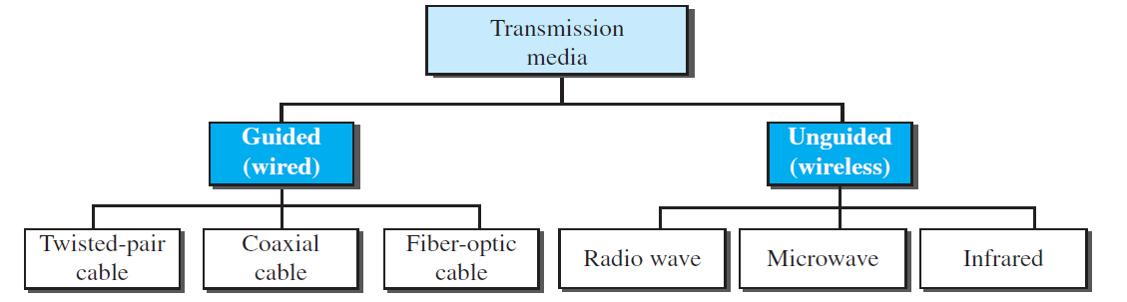
Transmission media
A transmission medium can be broadly defined as anything that can carry information from a source to a destination.

Slide 4
Guided Media
Guided media, which are those that provide a channel from one device to another, e.g. twisted-pair cable, coaxial cable, and fiber-optic cable.
A signal traveling along any of these media is directed and contained by the physical limits of the medium.
Twisted-pair and coaxial cable use metallic (copper) conductors that accept and transport signals in the form of electric current.
Optical fiber is a cable that accepts and transports signals in the form of light.

Slide 5
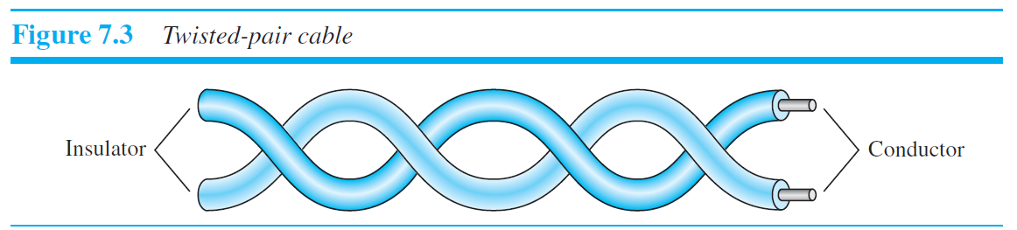
Twisted-Pair Cable
One of the wires is used to carry signals to the receiver, and the other is used only as a ground reference. The receiver uses the difference between the two
In addition to the signal sent by the sender on one of the wires, interference (noise) and crosstalk may affect both wires and create unwanted signals.

Slide 6
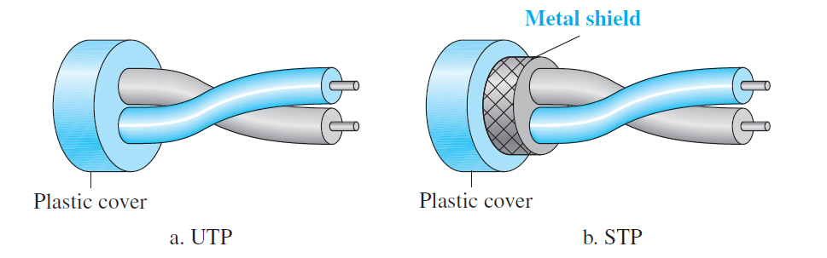
Twisted-Pair Cable
Although metal casing
improves the quality of cable by preventing the penetration of noise or crosstalk, it is
bulkier and more expensive.

Slide 7
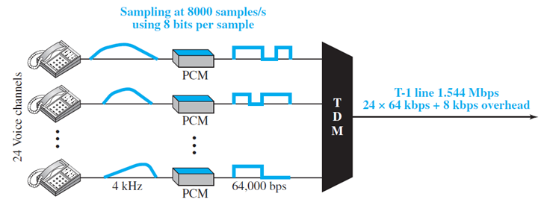
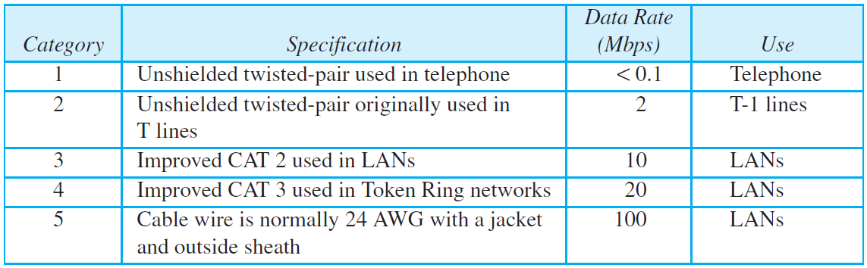
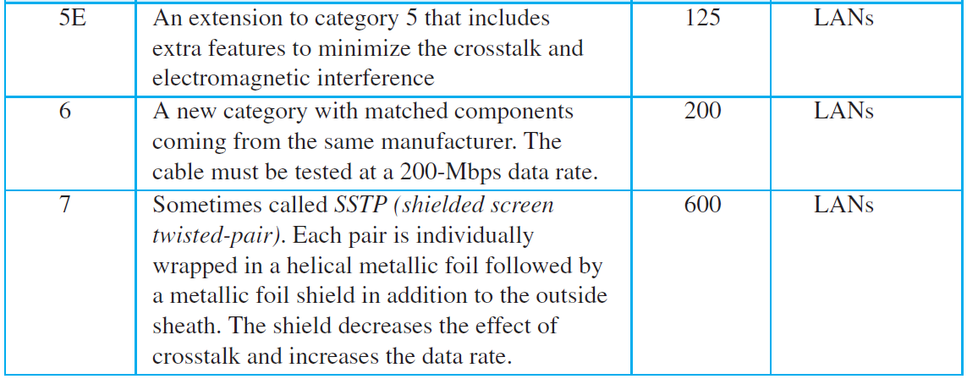
The Electronic Industries Association (EIA) has developed standards to classify unshielded twisted-pair cable into seven categories.
750 kHz
1 MHz
16 MHz
20 MHz
100 MHz
100 MHz
Cat 6/6e: 250 MHz
Cat6A: 600 MHz
laboratory tests have shown that it can transmit up to 40 Gbps at 50 meters and 100 Gbps at 15 meters.
Notes:
AWG, or American Wire Gauge

Slide 8
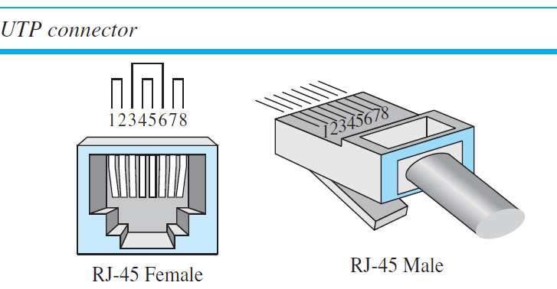
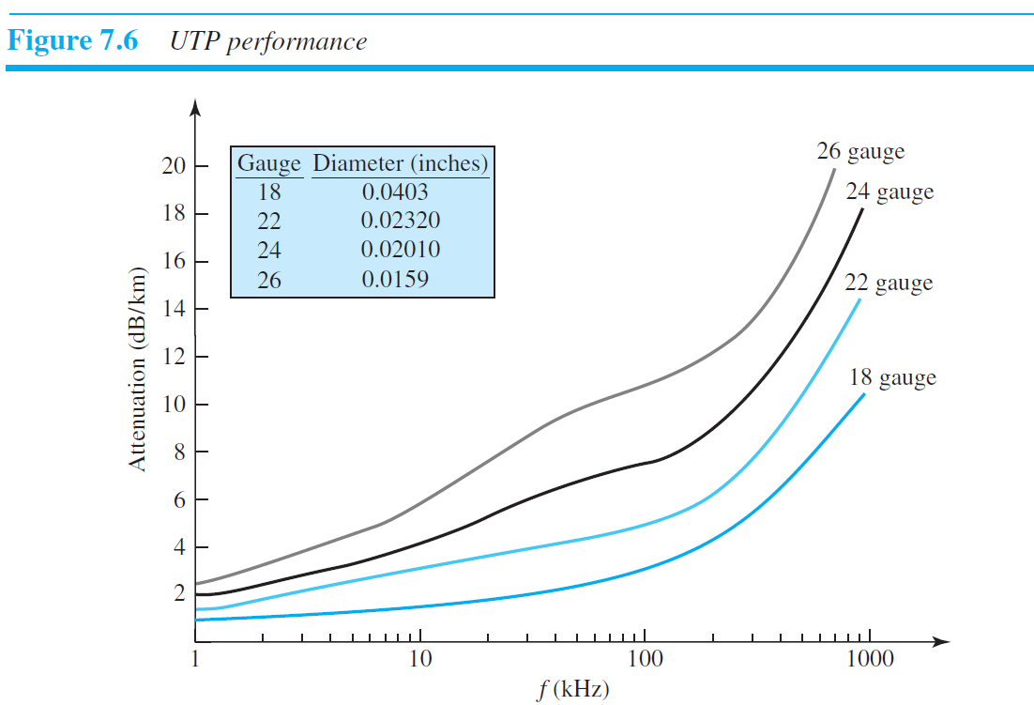
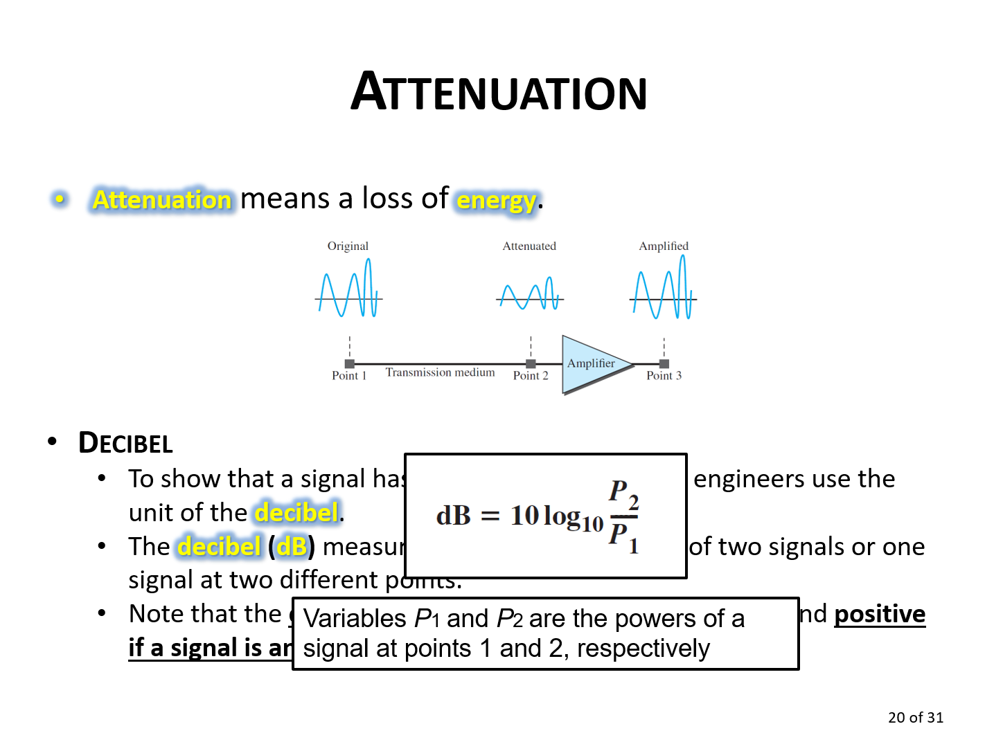
The most common UTP connector is RJ45
(RJ stands for registered jack),

Slide 9
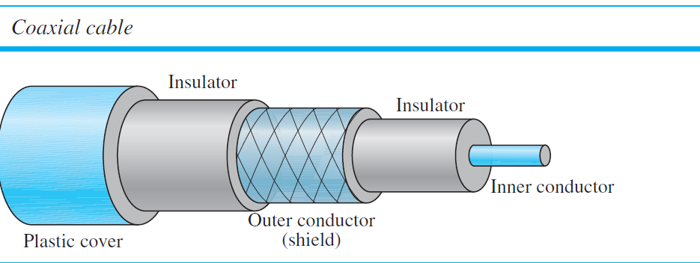
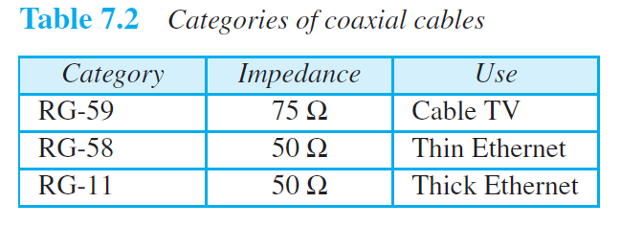
Coaxial Cable
Coaxial cable (or coax) carries signals of higher frequency ranges than those in twisted pair
cable
Coaxial cables are categorized by their Radio Government (RG) ratings.

Slide 10
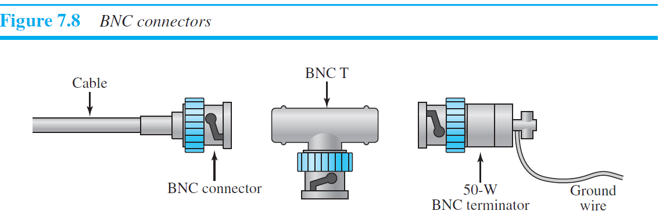
The most common type of connector used today is the Bayonet Neill-Concelman (BNC) connector.
10 Mbps with a range of 185 m.
10 Mbps with a range of 5000 m.

Slide 11
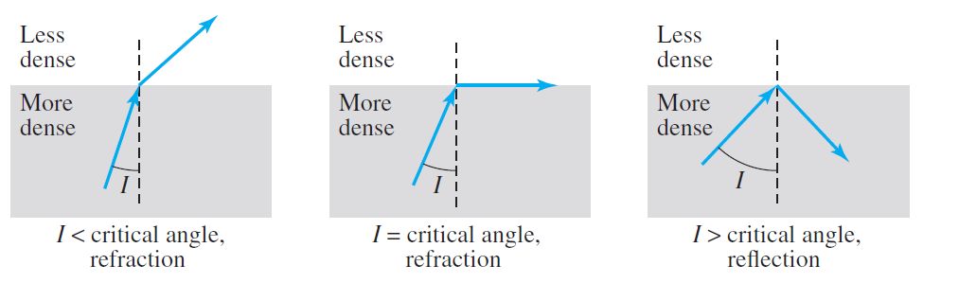
Fiber-Optic Cable
A glass or plastic core is surrounded by a cladding of less dense glass or plastic. The difference in density of the two materials must be such that a beam of light moving through the core is reflected off the cladding instead of being refracted into it

Slide 12
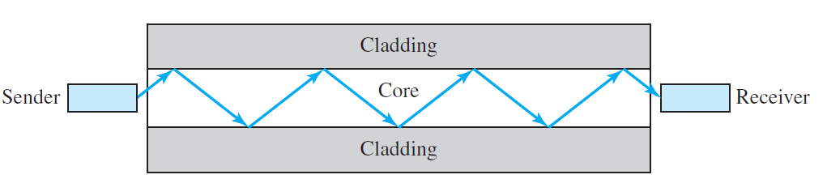
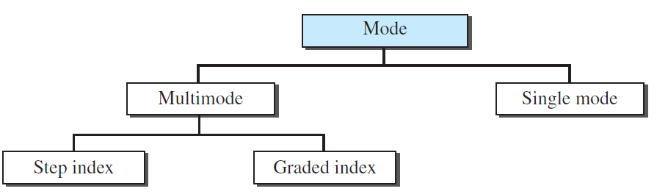
Propagation Mode

Slide 13
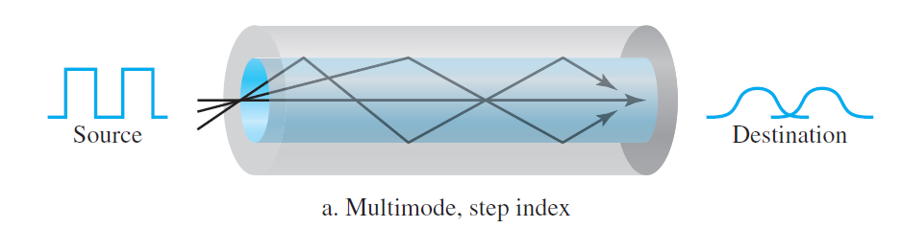
In multimode step-index fiber, the density of the core remains constant from the center to the edges.
A beam of light moves through this constant density in a straight line until it reaches the interface of the core and the cladding.
At the interface, there is an abrupt change due to a lower density; this alters the angle of the beam’s motion.
The term step-index refers to the suddenness of this change, which contributes to the distortion of the signal as it passes through the fiber.

Slide 14
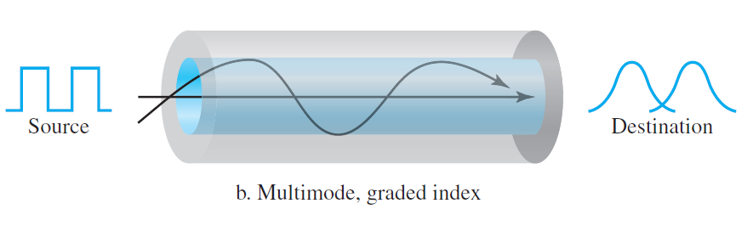
A second type of fiber, called multimode graded-index fiber, decreases this distortion of the signal through the cable.
The word index here refers to the index of refraction.
As we saw above, the index of refraction is related to density.
A graded-index fiber, therefore, is one with varying densities.
Density is highest at the center of the core and decreases gradually to its lowest at the edge.

Slide 15
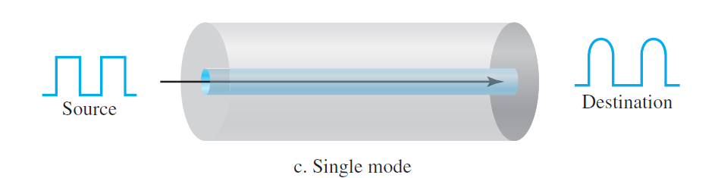
Single-mode uses step-index fiber and a highly focused source of light that limits beams to a small range of angles, all close to the horizontal.
The single-mode fiber itself is manufactured with a much smaller diameter than that of multimode fiber, and with substantially lower density (index of refraction).
The decrease in density results in a critical angle that is close enough to 90° to make the propagation of beams almost horizontal.
In this case, propagation of different beams is almost identical, and delays are negligible.

Slide 16
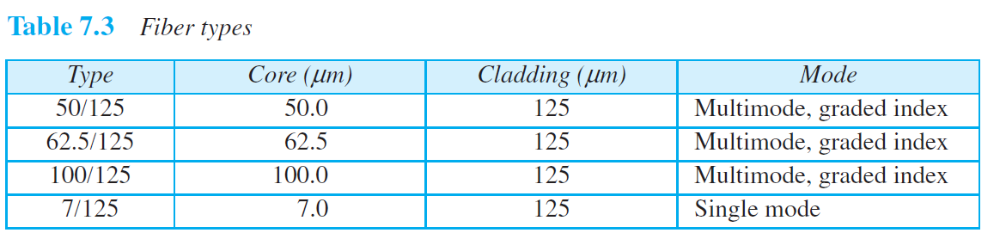
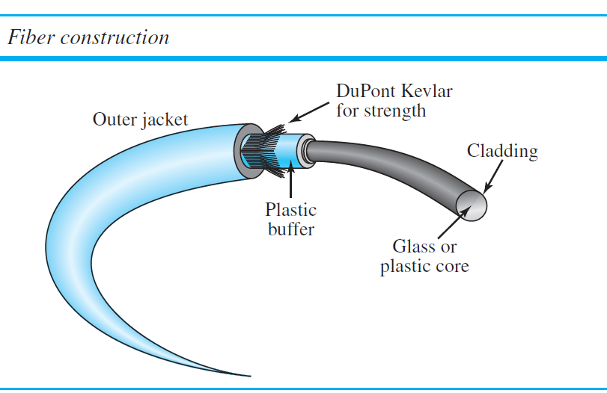

Slide 17
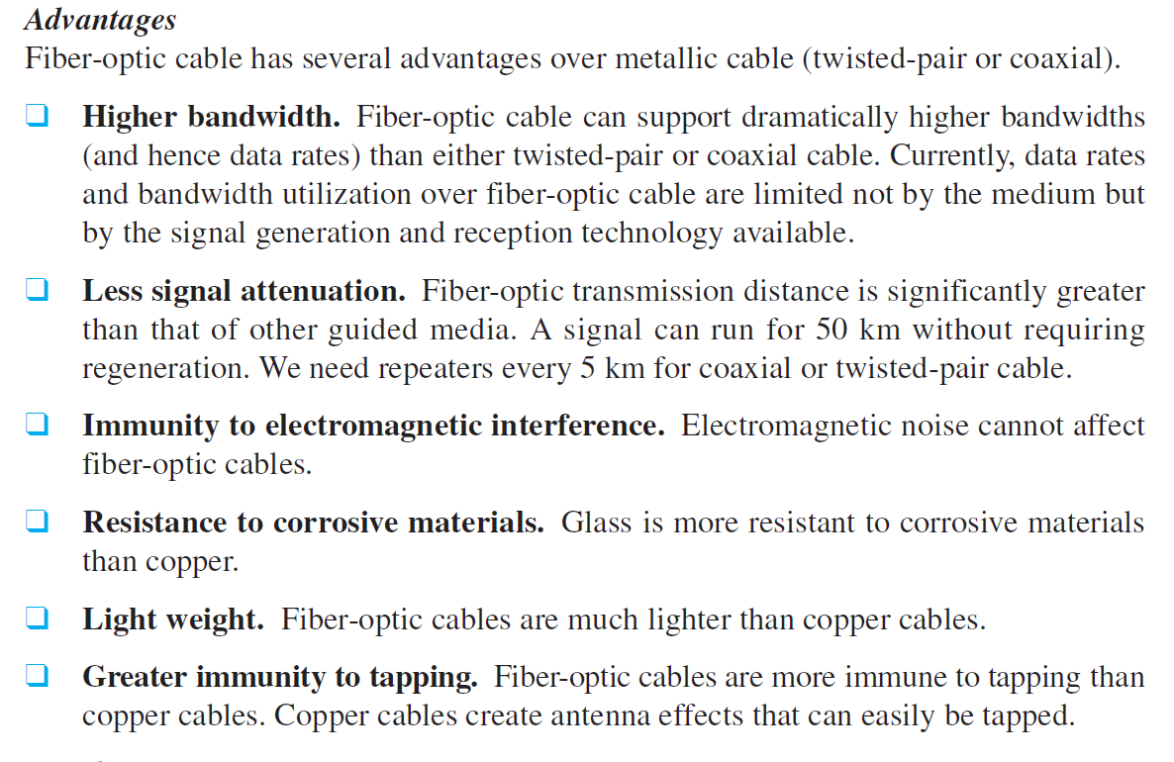
Adv. and Disadvantages of Optical Fiber
ক্ষয়কারী

Slide 18
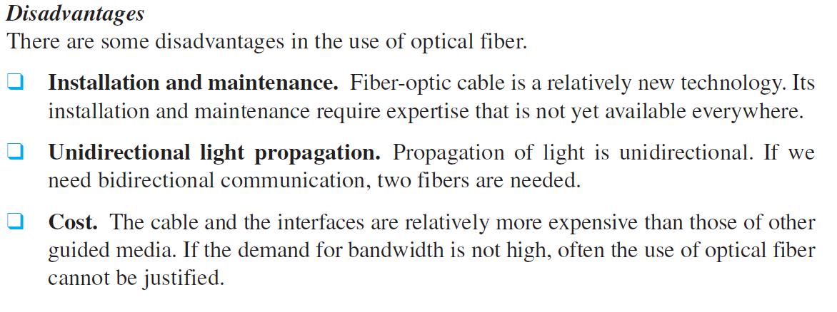
Adv. and Disadvantages of Optical Fiber

Slide 19
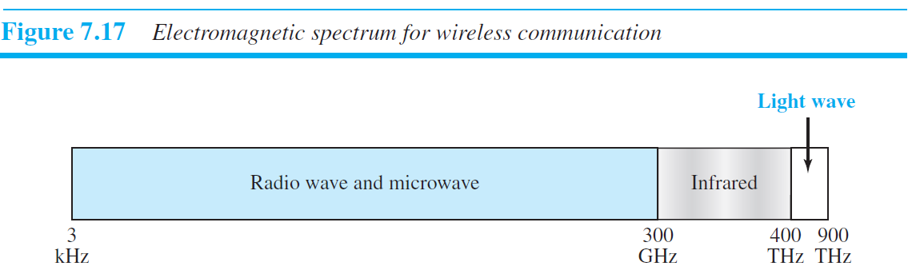
Unguided Media: Wireless

Slide 20
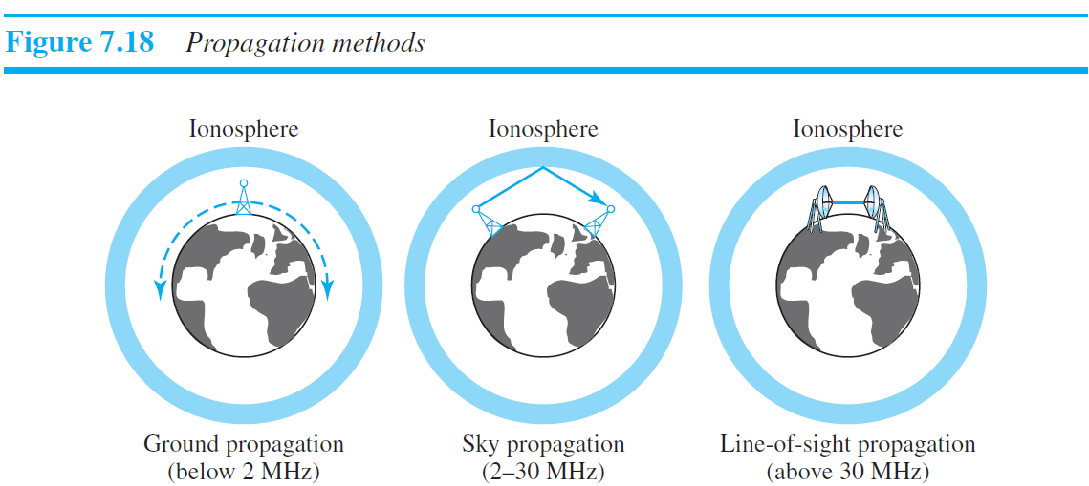
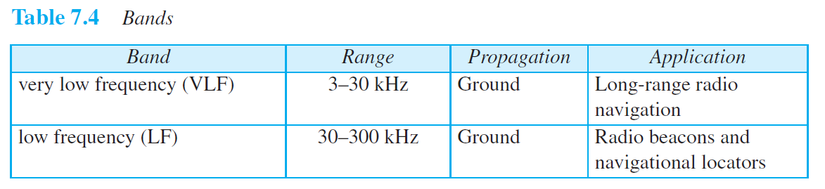
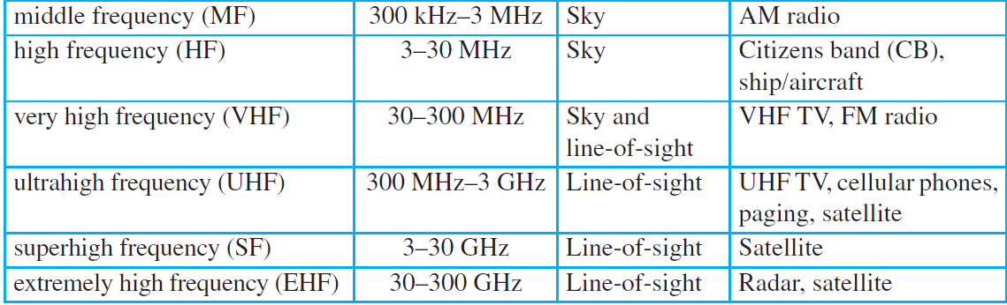

Slide 21
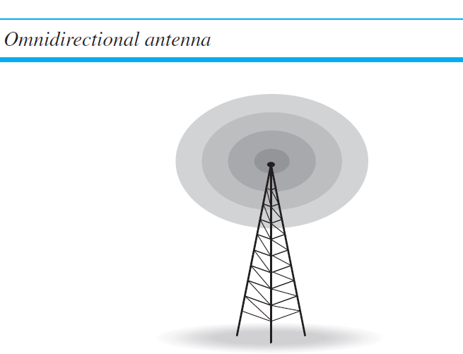
Electromagnetic waves ranging …between 3 kHz and 1 GHz called radio waves;
Waves … between 1 and 300 GHz are called microwaves.
Radio waves use omnidirectional antennas that send out signals in all directions.
Based on the wavelength, strength, and the purpose of transmission, we can have several types of antennas.

Slide 22
Radio waves, for the most part, are omnidirectional.
The omnidirectional property has a disadvantage, too.
The radio waves transmitted by one antenna are at risk to interference by another antenna that may send signals using the same frequency or band.
Radio waves, particularly those waves that propagate in the sky mode, can travel long distances.
Radio waves, particularly those of low and medium frequencies, can penetrate walls.

Slide 23
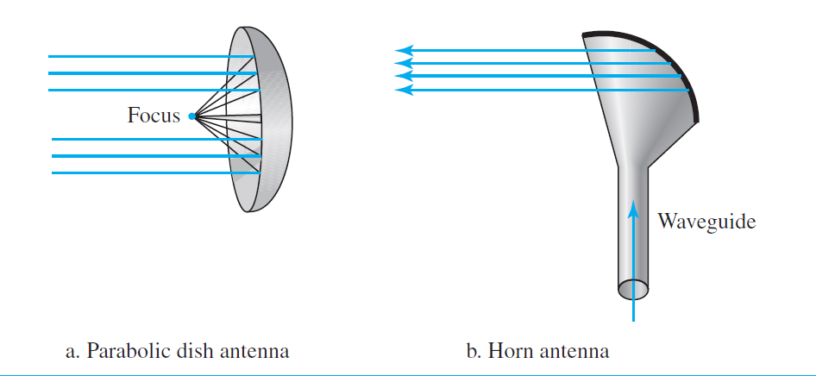


Slide 24
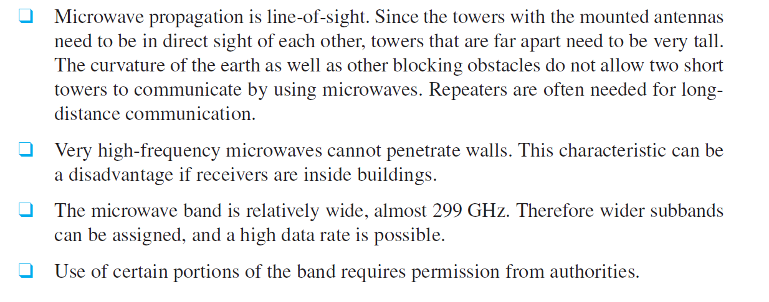

Slide 25
Infrared

